Slide 1
Seismic acquisition – a simple geological model

Slide 2
Seismic acquisition – a survey vessel

Slide 3
Seismic acquisition – the source
Air gun (source)

Slide 4
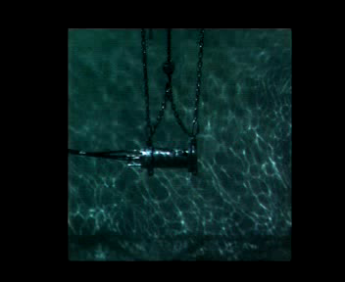
Seismic acquisition – the source
Air gun (source)
INSERT AIR GUN VIDEO

Slide 5
Seismic acquisition – the receivers
Hydrophones (receivers)
Air gun (source)

Slide 6
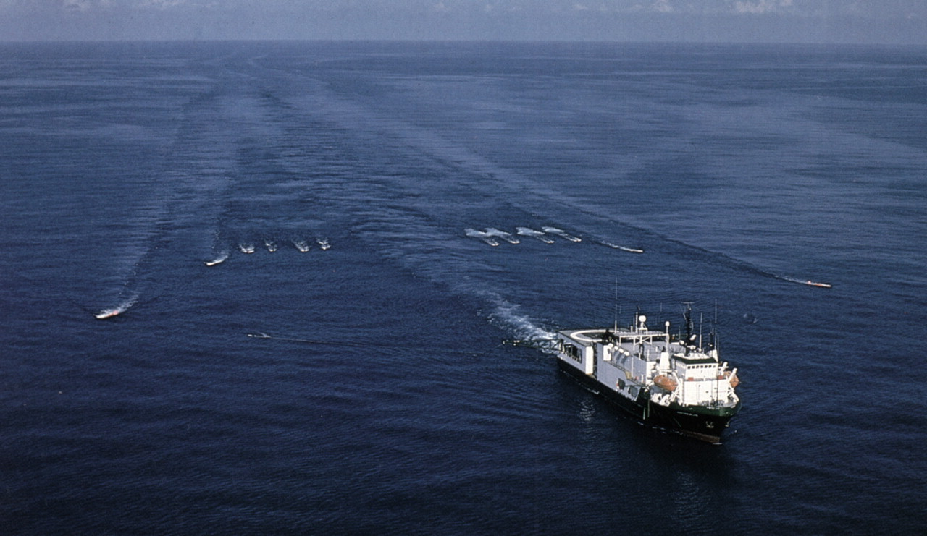
Seismic acquisition – the receivers
Hydrophones (receivers)
Air gun (source)
INSERT STREAMER PIC
Dragoset, B., A historical reflection of reflections, TLE, 2005

Slide 7

Seismic acquisition – pressure wavefield

Slide 8
Seismic acquisition – pressure data

Slide 9
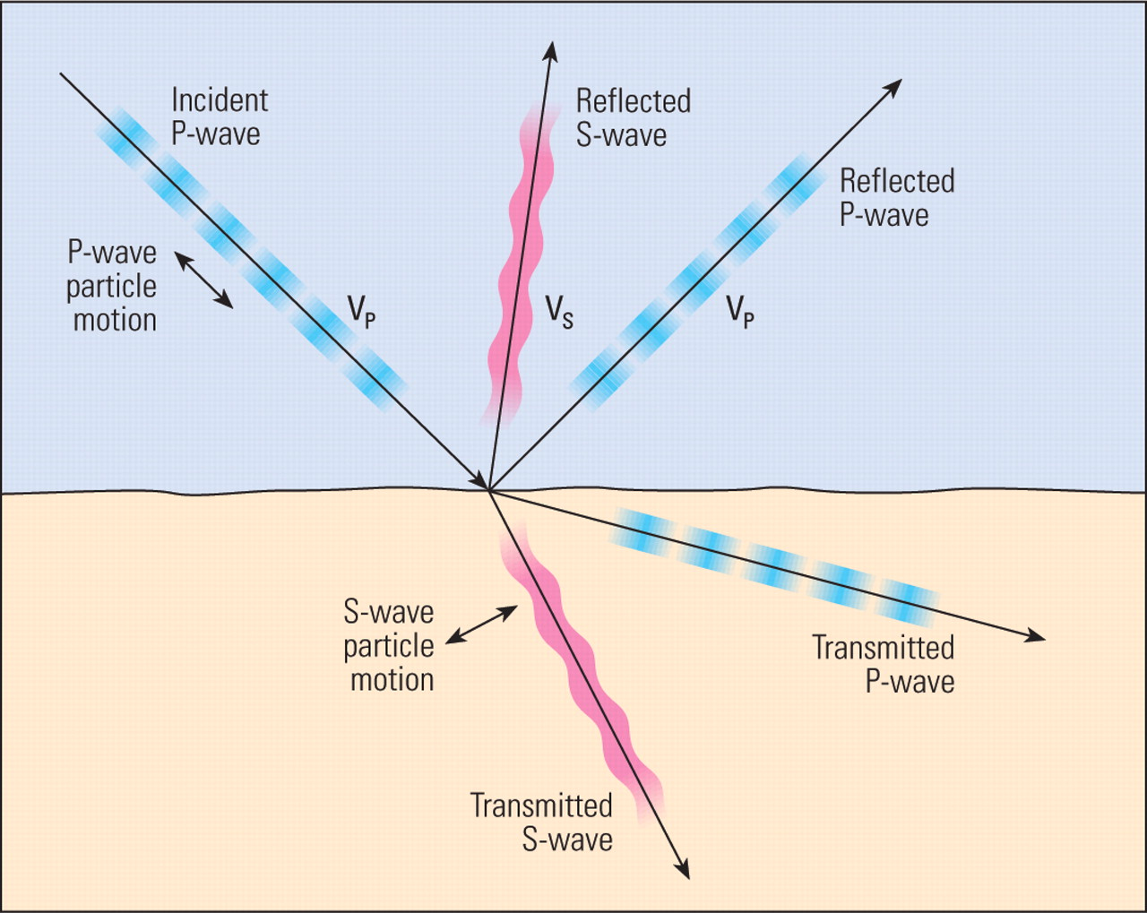
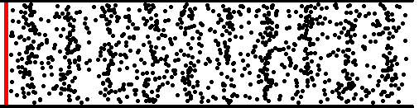
Wave partitioning at an interface – acoustic modes
P-wave particle motion
Dragoset, B., A historical reflection of reflections, TLE, 2005

Slide 10
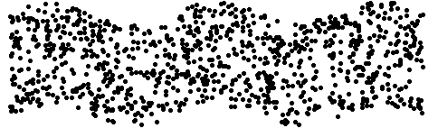

Wave partitioning at an interface – elastic modes
P-wave particle motion
S-wave particle motion
Surface waves
Dragoset, B., A historical reflection of reflections, TLE, 2005

Slide 11
Seismic acquisition – comparing pressure wavefields
Difference Elastic Acoustic

Slide 12

Seismic acquisition – comparing pressure wavefields
Difference Elastic Acoustic

Slide 13
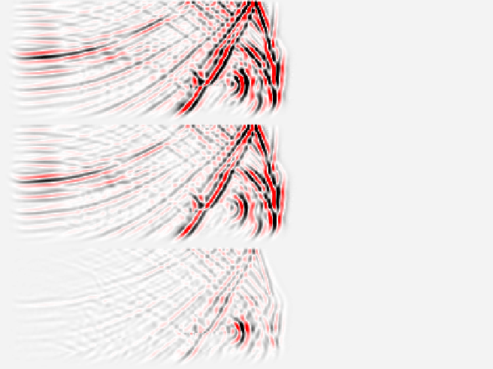
Seismic acquisition – comparing pressure wavefields
Difference Elastic Acoustic

